Slide 1

Simulated Digital Patients
…for the deliberate practice of medical history taking
Notes:
My name is Ammar Waraich. I am a physician, a professional medical educator, and a tech enthusiast.
Today, I am pitching Humaine, a medical edtech company.

Slide 2

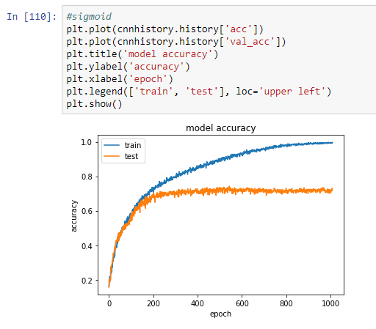

Technical Highlights
Sentiment Analysis Model

